Slide 1

Indian Society For Technical Education
Computer Vision using OpenCV

Slide 2
01
02
04
03
05
Setting up python and openCV
Opening and reading images
Will go through fundamentals of pip install
Will go through the basic OpenCv functions and operations
Here you could describe the topic of the section
Colour Detection
About colour schemes
Will use the colour scheme knowledge to detect objects
Will get to know about the colour schemes .
Virtual Background
Adding the virtual background to live videcaptures.

Slide 3
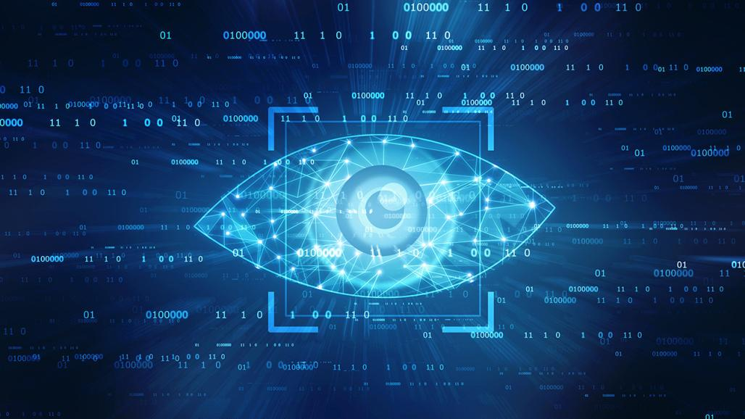
Computer Vision
In 1966, Seymour Papert and Marvin Minsky, two pioneers of artificial intelligence, launched the Summer Vision Project, a two-month, 10-man effort to create a computer system that could identify objects in images.
*Credits: https://www.pcmag.com/

Slide 4
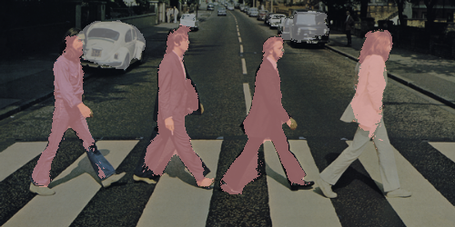
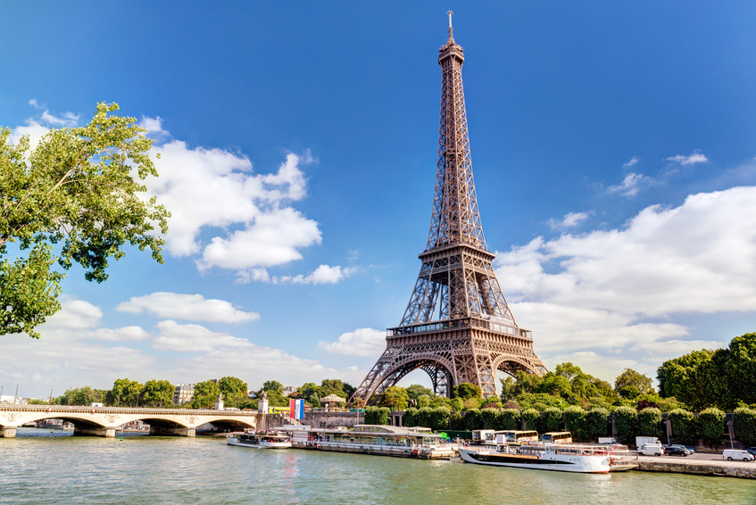
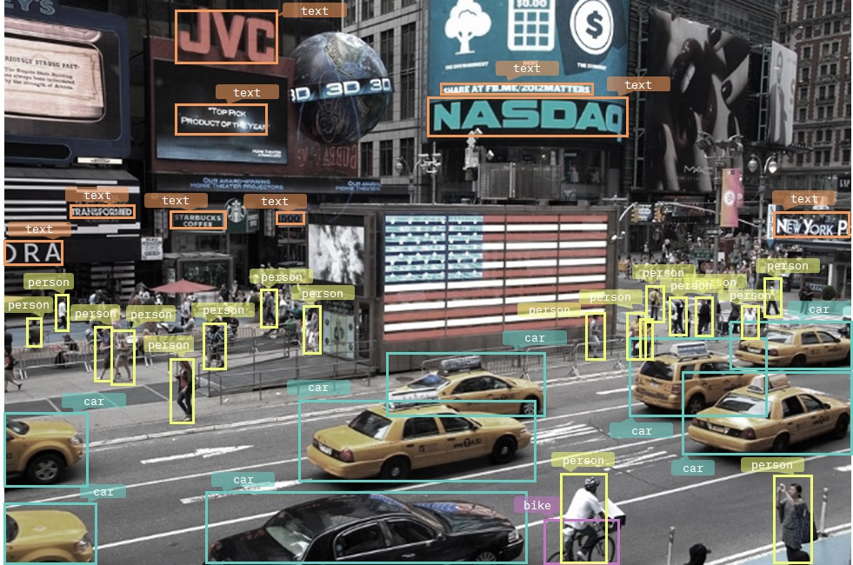
Some typical tasks of Computer Vision
Instance segmentation
Image classification
Object detection
Object tracking
*credits : https://tryolabs.com/

Slide 5
Why OpenCV ?
Over 2500 optimized algorithms
Open source library for Computer Vision
Can be integrated with several platforms
Has Cross Platform interfaces
Credits: https://opencv.org/about/

Slide 6
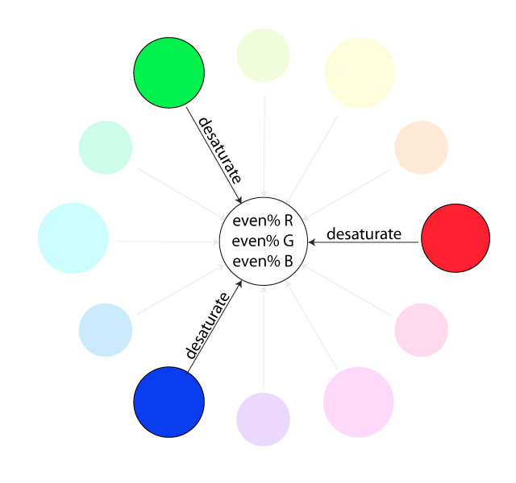
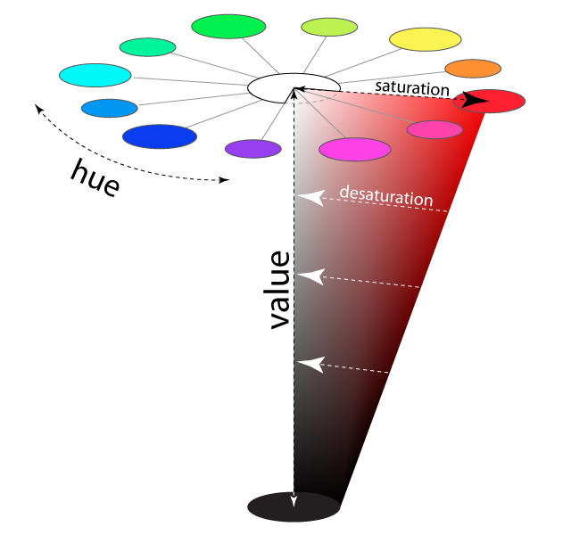
Understanding Colour Schemes
Credits:http://learn.leighcotnoir.com/artspeak/elements-color/hue-value-saturation/

Slide 7


BitWise Operations in openCV
IMage 1
Image 2
Credits:https://www.geeksforgeeks.org/arithmetic-operations-on-images-using-opencv-set-2-bitwise-operations-on-binary-images/

Slide 8
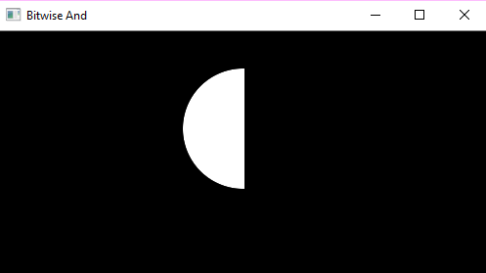
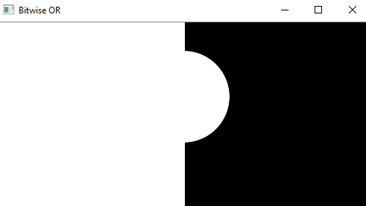
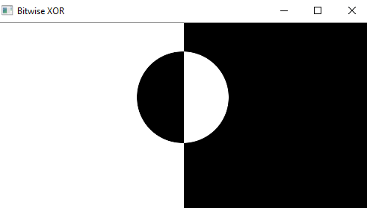
Bitwise operations results
Add bitwise operator
Or bitwise operator
Xor bitwise operator

Slide 9
INdian Society for technical education
istevit.in
instagram.com/iste_vit_vellore
facebook.com/ISTE.VIT
linkedin.com/company/indian-society-for-technical-education
github.com/ISTE-VIT
About me
Jayesh Singh
github.com/jaguar017
linkedin.com/in/jayesh-singh-98872b1a1
bgfbdfdssdvdcsabdfvsdfasdsdAS

Slide 10
THANK YOu !

